Slide 1
Smart Blinds
William Christmas
Joe Routhieaux

Slide 2
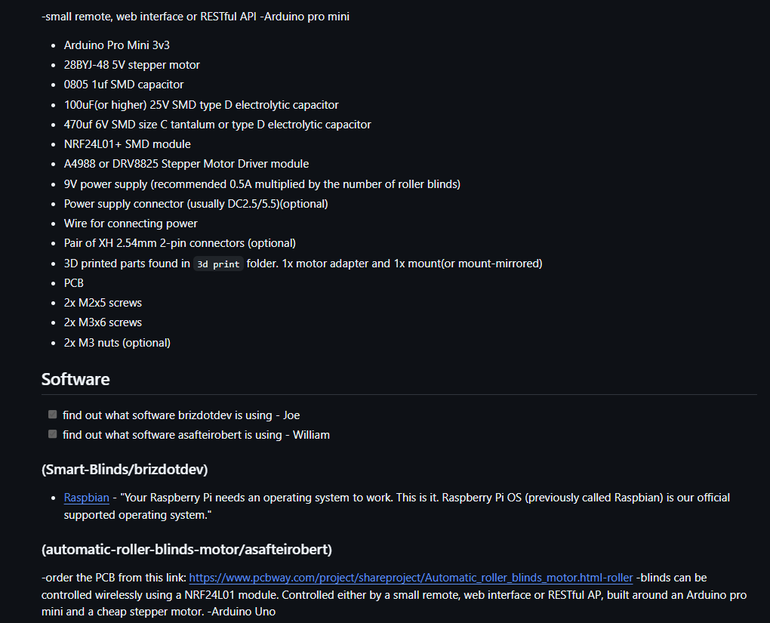
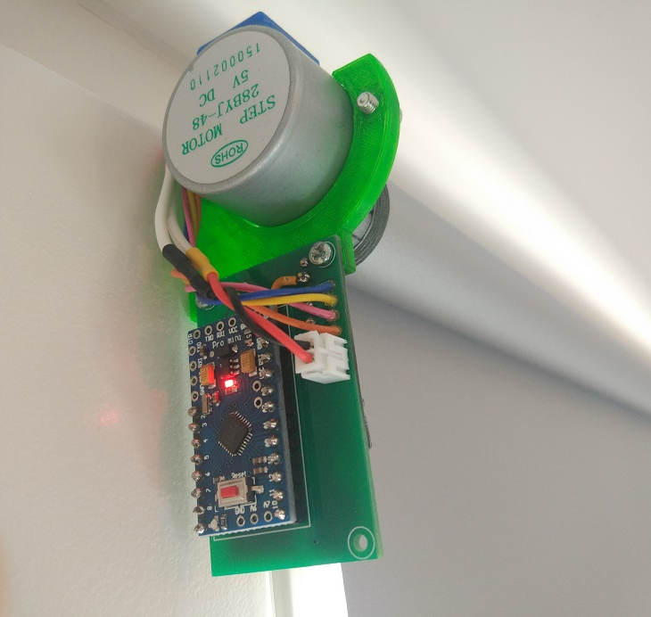
Main Concept
Smart Blinds
William Christmas | Joe Routhieaux
The goal is to create a program that will utilize a raspberry pi as well as sensors/actuators, to automatically open your blinds in the morning. These sensors will include a sunlight sensor and a motor to spin the "wand"

